Slide 1
Data Structures
23. Graphs

Slide 2
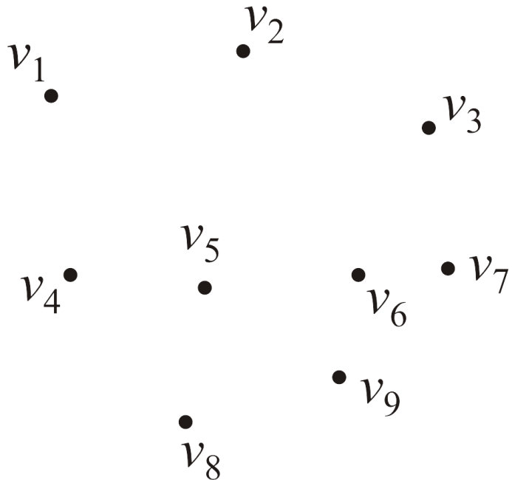
Graphs
Consider this collection of vertices
V = {v₁, v₂, ..., v₉}
Where |V| = n

Slide 3
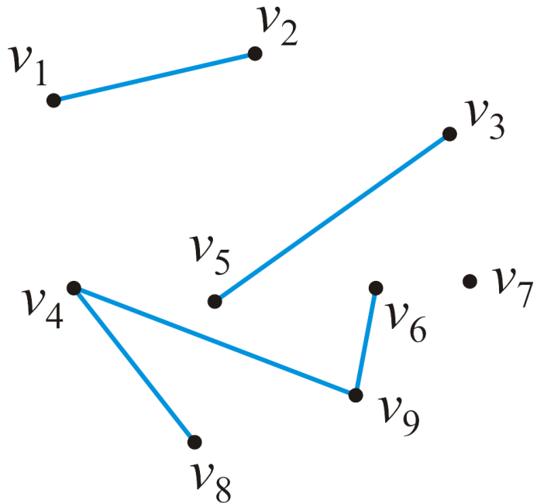
Graphs
Associated with these vertices are |E| = 5 edges
E = {{v₁, v₂}, {v₃, v₅}, {v₄, v₈}, {v₄, v₉}, {v₆, v₉}}
Pair {v_{j} , v_{k}} indicates following relations
Vertex v_{j} is adjacent to vertex v_{k}
Vertex v_{k} is adjacent to vertex v_{j}

Slide 4
Applications Of Graphs
Driving Map
Vertex = Intersection, destinations
Edge = Road
Airline Traffic
Vertex = Cities serviced by the airline
Edge = Flight exists between two cities
Computer networks
Vertex = Server nodes, end devices, routers
Edge = Data link

Slide 5
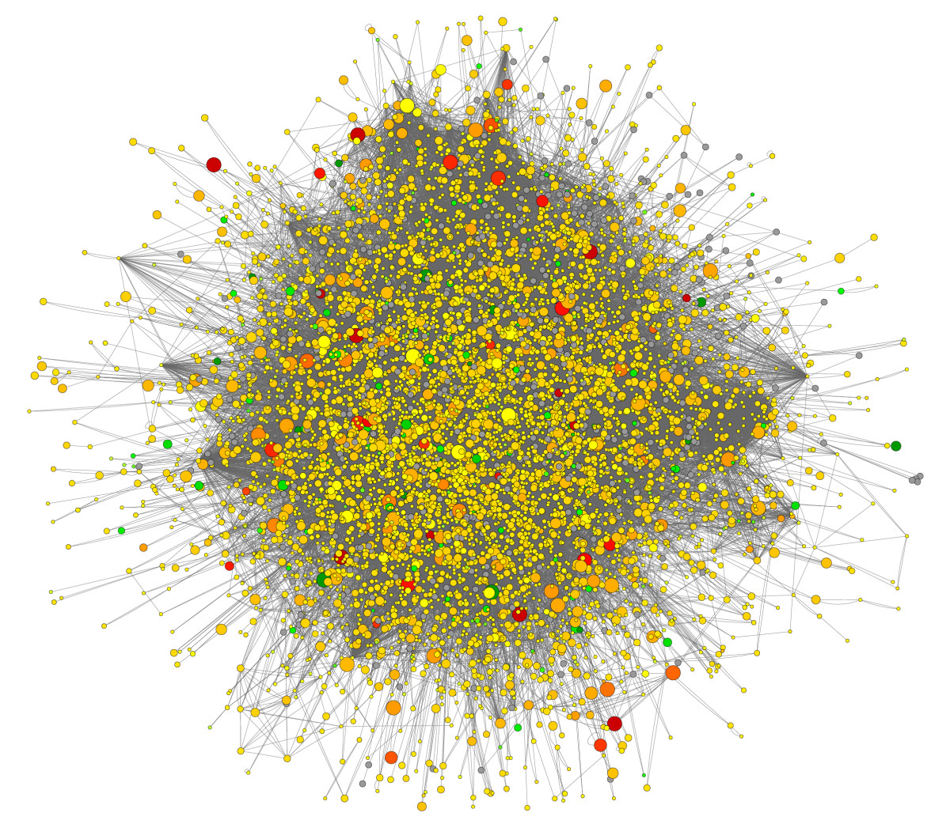
Applications Of Graphs
Many real-world applications concern large graphs
Web document graph - 1 trillion webpages
Vertex = Webpage
Edge = Hyperlink
Social networks - 1.3 billion users
Vertex = Users
Edge = Friendship relation

Slide 6
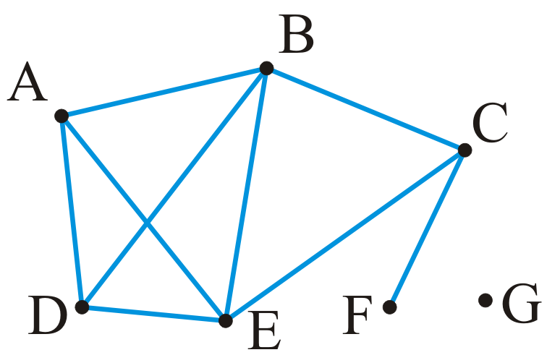
Undirected Graphs – Example
Given |V| = 7 vertices and |E| = 9 edges
V = {A, B, C, D, E, F, G}
E = {{A, B}, {A, D}, {A, E}, {B, C}, {B, D}, {B, E},
{C, E}, {C, F}, {D, E}}

Slide 7
Undirected Graphs – Definition
An undirected Graph is defined as G=(V,E) consisting of
Set V of vertices: V = {v₁, v₂, ..., v_{n}}
Number of vertices is denoted by |V| = n
Set E of unordered pairs {v_{i}, v_{j}} termed edges
Edges connect the vertices
Maximum number of edges in an undirected graph is O(|V|²)
Assumption: A vertex is never adjacent to itself
For example, {v₁, v₁} will not define an edge
Many data structures can implement abstract undirected graphs
Adjacency matrices, Adjacency lists
Notes:
n!/k! (n-k)!

Slide 8
Degree
Degree of a vertex is defined as the number of adjacent vertices
degree(A) = degree(D) = degree(C) = 3
degree(B) = degree(E) = 4
degree(F) = 1
degree(G) = 0
Vertices adjacent to a given vertex are its neighbors

Slide 9

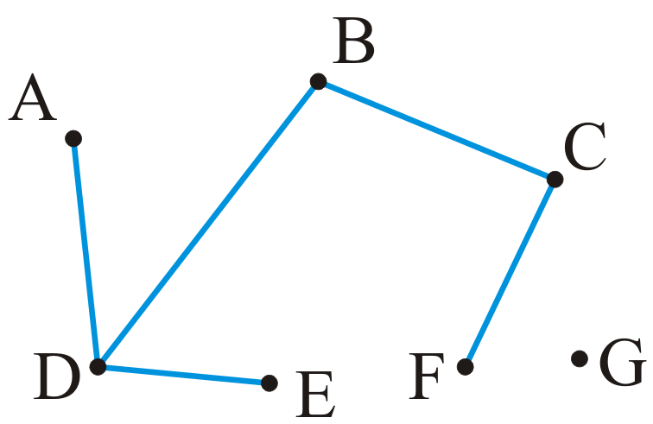
Subgraph
A sub-graph of a graph G is defined by
Subset of the vertices
Subset of the edges that connected the subset of vertices in the original graph
Every graph is a subgraph of itself
Notes:
Set of vertices and edges are all subset of G

Slide 10
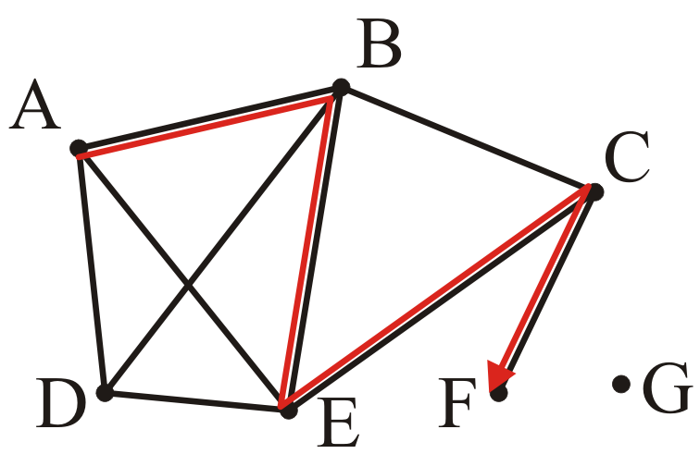
Path
Path in an undirected graph is an ordered sequence of vertices
Consecutive vertices are connected through edges
Path from vertex 0 to vertex k is (v₀, v₁, v₂, ..., v_{k})
where {v_{j} – 1, v_{j}} is an edge for j = 1, ..., k
Length of a path is equal to the number of edges
Example: Path from A to F
Path: (A, B, E, C, F)
Length of the path is 4

Slide 11
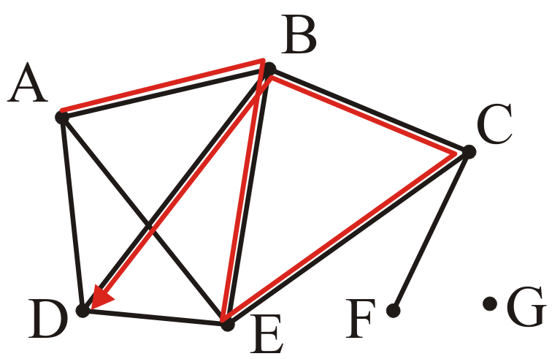
Path – Example
Path of length 5: (A, B, E, C, B, D)
Repitition of vertex B

Slide 12
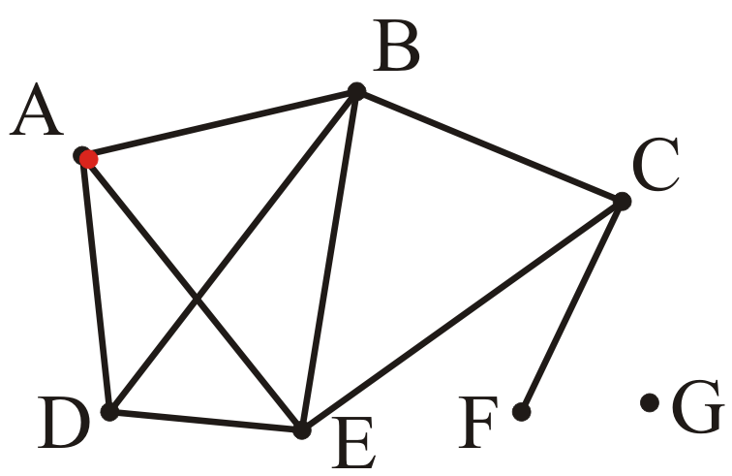
Path – Example
A trivial path of length 0: (A)

Slide 13
Simple Path
A simple path has no repetitions other than perhaps the first and last vertices
A simple cycle is a simple path of at least two vertices with the first and last vertices equal
Note: these definitions are not universal
A loop is an edge from a vertex onto itself

Slide 14
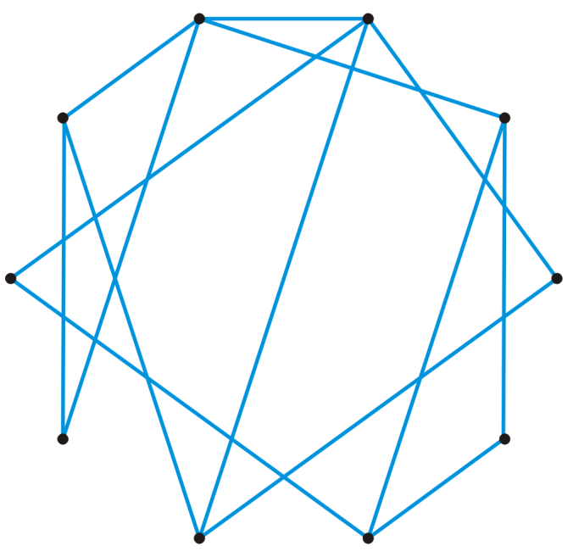
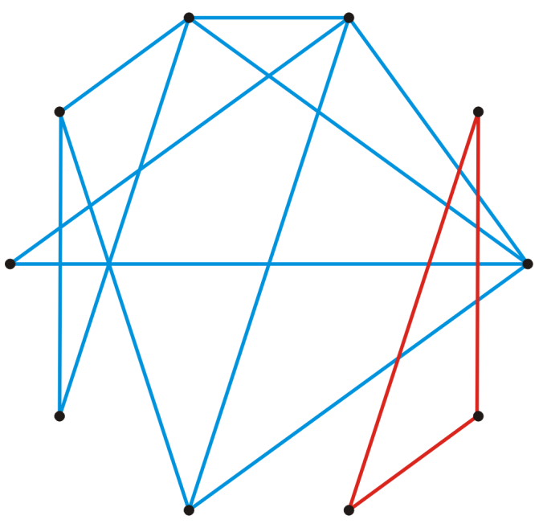
Connectedness
Two vertices v_{i}, v_{j} are said to be connected if there exists a path from v_{i} to v_{j}
A graph is connected if there exists a path from every vertex to every other vertex
A connected graph
An unconnected graph

Slide 15
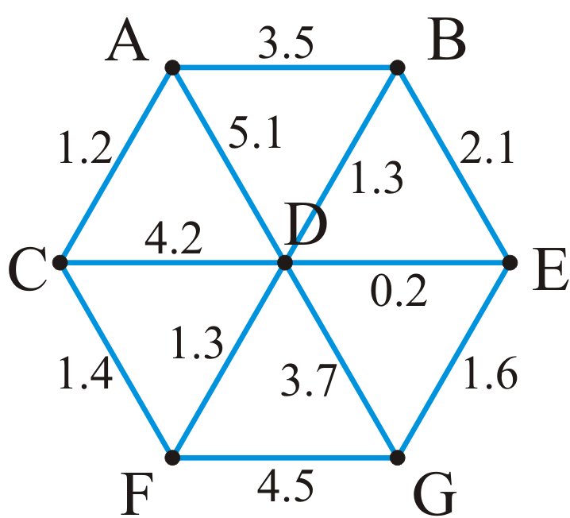
Weighted Graphs
A weight may be associated with each edge in a graph
This could represent distance, energy consumption, cost, etc.
Such a graph is called a weighted graph
Pictorially, we will represent weights by numbers next to the edges

Slide 16
Weighted Graphs
Length of a path within a weighted graph is the sum of all of the edges which make up the path
The length of the path (A, D, G) in the following graph is 8.8

Slide 17
Weighted Graphs – Example
Different paths may have different weights
Another path is (A, C, F, G) with length 1.2 + 1.4 + 4.5 = 7.1

Slide 18
Weighted Graphs – Example
Find the shortest path between two vertices A and G
Shortest path is (A, C, F, D, E, G) with length 5.7

Slide 19
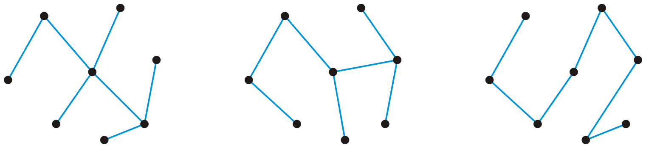
Trees
A graph is a tree if it satisfies the following two conditions
Graph is connected
There is a unique path between any two vertices
Consequences
The number of edges is |E| = |V| – 1
The graph is acyclic, that is, it does not contain any cycles
Adding one more edge must create a cycle
Removing any one edge creates two disjoint non-empty sub-graphs
Three trees on same 8 vertices

Slide 20
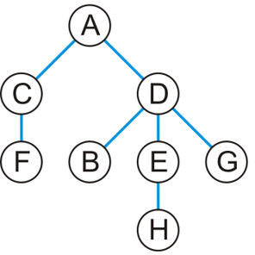
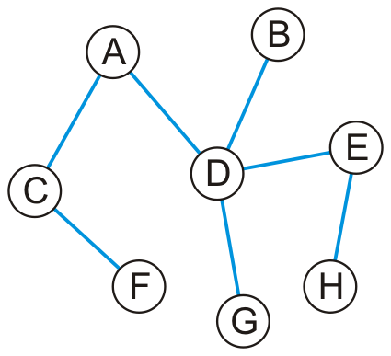
Trees
Any tree can be converted into a rooted tree by
Choosing any vertex to be the root
Defining its neighboring vertices as its children
Recursively defining
All neighboring vertices other than that one designated as parent to be that vertex children
Unrooted Tree
Tree rooted at A

Slide 21
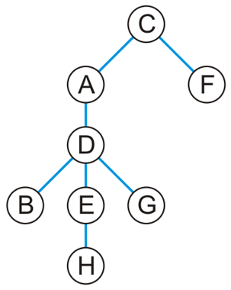
Trees – Example
Unrooted Tree
Tree rooted at C

Slide 22
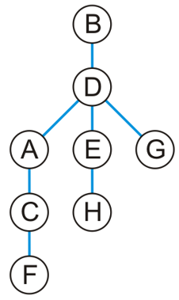
Trees – Example
Unrooted Tree
Tree rooted at B

Slide 23
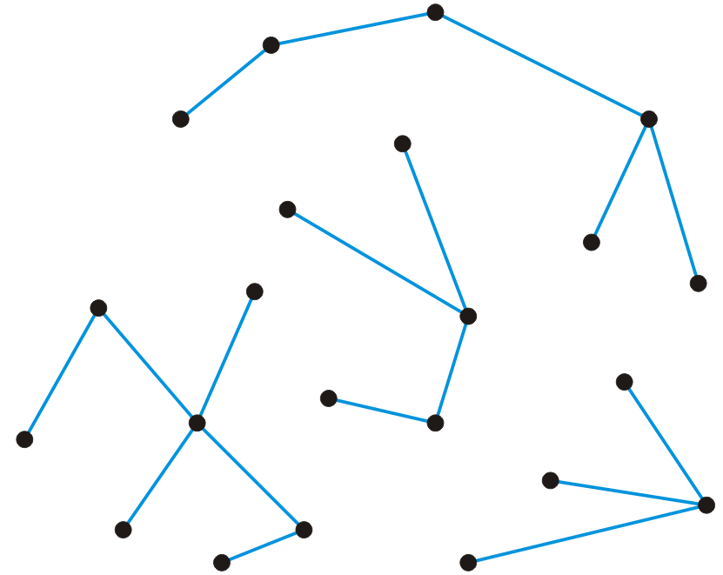
Forest
A forest is any graph that has no cycles
Consequences
The number of edges is |E| < |V|
The number of trees is |V| – |E|
Removing any one edge adds one more tree to the forest
Forest with 22 vertices and 18 edges
Four trees
Notes:
Here is a forest with 22 vertices and 18 edges
There are four trees

Slide 24
Directed Graphs
In a directed graph, the edges on a graph are associated with a direction
Edges are ordered pairs (v_{j}, v_{k}) denoting a connection from v_{j} to v_{k}
The edge (v_{j}, v_{k}) is different from the edge (v_{k}, v_{j})
Streets are directed graphs
In most cases, you can go two ways unless it is a one-way street

Slide 25
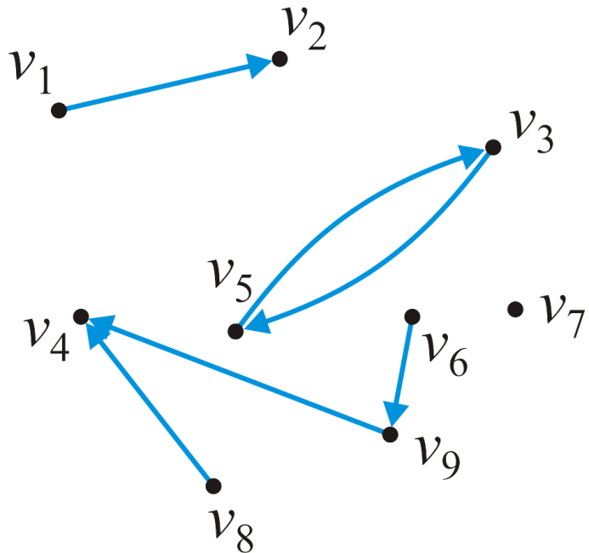
Directed Graphs
Given our graph of nine vertices V = {v₁, v₂, … v₉}
These six pairs (v_{j} , v_{k}) are directed edges
E = {(v₁, v₂), (v₃, v₅), (v₅, v₃), (v₆, v₉), (v₈, v₄),
(v₉, v₄)}

Slide 26
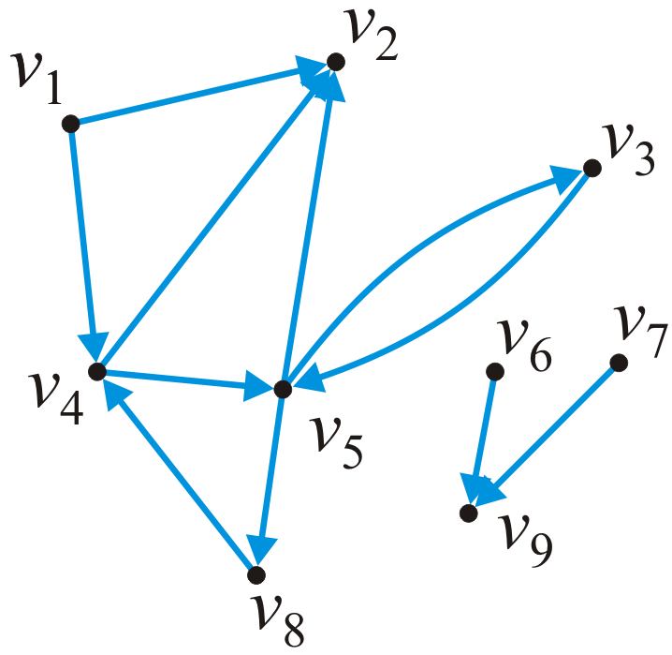
In and Out Degree
Degree of a vertex must be modified to consider both cases:
Out-degree of a vertex is the number of vertices which are adjacent to the given vertex
Number of outgoing edges
In-degree of a vertex is the number of vertices which this vertex is adjacent to
Number of incoming edges
In this graph:
In-degree(v₁) = 0 out-degree(v₁) = 2
In-degree(v₅) = 2 out-degree(v₅) = 3

Slide 27
Path
A path in a directed graph is an ordered sequence of vertices
(v₀, v₁, v₂, ..., v_{k})
where (v_{j} – 1, v_{j}) is an edge for j = 1, ..., k
A path of length 5 in this graph is
(v₁, v₄, v₅, v₃, v₅, v₂)
A simple cycle of length 3 is
(v₈, v₄, v₅, v₈)

Slide 28
Connectedness
Two vertices v_{j}, v_{k} are said to be connected if there exists a path from v_{j} to v_{k}
A graph is strongly connected if there exists a directed path between any two vertices
A graph is weakly connected if there exists a path between any two vertices that ignores the direction

Slide 29
Connectedness – Example
The sub-graph {v₃, v₄, v₅, v₈} is strongly connected
The sub-graph {v₁, v₂, v₃, v₄, v₅, v₈} is weakly connected

Slide 30
Weighted Directed Graphs
Each edge is associated with a value
If both (v_{j}, v_{k}) and (v_{j}, v_{k}) are edges
It is not required that they have the same weight
6.4
7.5
6.8
6.7
7.3
5.9
4.1
3.2
4.7
5.4
4.5

Slide 31
Representation
How do we store the adjacency relations?
Adjacency matrix
Adjacency list

Slide 32
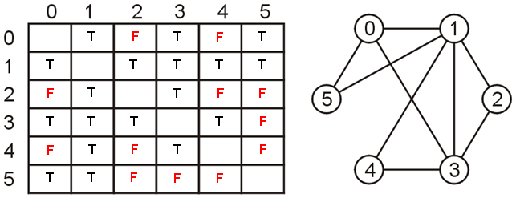
Adjacency Matrix
Two-dimensional matrix of size n x n where n = |V|
a[i, j] = 0 (F) if there is no edge between vertices v_{i} and v_{j}
a[i, j] = 1 (T) if there is an edge between vertices v_{i} and v_{j}
Adjacency matrix of undirected graphs is symmetric
a[i, j] = a[j, i]
F
F
F
F
F
F

Slide 33
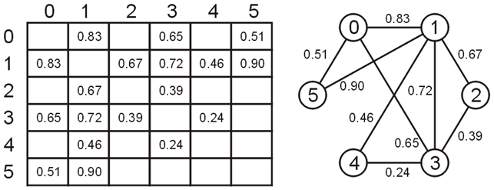
Adjacency Matrix – Weighted Graph
The matrix entry [j, k] is set to the weight of the edge (v_{j}, v_{k})
How to indicate absence of an edge in the graph?

Slide 34
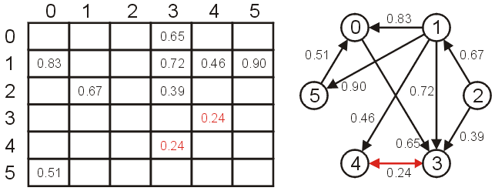
Adjacency Matrix – Directed Graph
For directed graph the matrix would not necessarily be symmetric

Slide 35
Adjacency Matrix – Analysis
Requires memory : O(|V|²)
Determining if v_{j} is adjacent to v_{k} : O(1)
Finding all neighbors of v_{j} : O(|V|)
 | 1 | 2 | 3 | 4 | 5 | 6 | 7 | 8 | 9
1 |  | 1 |  | 1
2
3 |  |  |  |  | 1
4 |  | 1 |  |  | 1
5 |  | 1 | 1 |  |  |  |  | 1
6 |  |  |  |  |  |  |  |  | 1
7 |  |  |  |  |  |  |  |  | 1
8 |  |  |  | 1
9

Slide 36
Adjacency Matrix – Problem
Very sparsely populated
Out of 81 cells only 11 are 1 (or T)
 | 1 | 2 | 3 | 4 | 5 | 6 | 7 | 8 | 9
1 |  | 1 |  | 1
2
3 |  |  |  |  | 1
4 |  | 1 |  |  | 1
5 |  | 1 | 1 |  |  |  |  | 1
6 |  |  |  |  |  |  |  |  | 1
7 |  |  |  |  |  |  |  |  | 1
8 |  |  |  | 1
9

Slide 37
Adjacency List
Each vertex is associated with a list of its neighbors
A vertex w is inserted in the list for vertex v if edge (v, w) exists
Requires memory : O(|V| + |E|)
1 • → 2 → 4
2 •
3 • → 5
4 • → 2 → 5
5 • → 2 → 3 → 8
6 • → 9
7 • → 9
8 • → 4
9 •

Slide 38
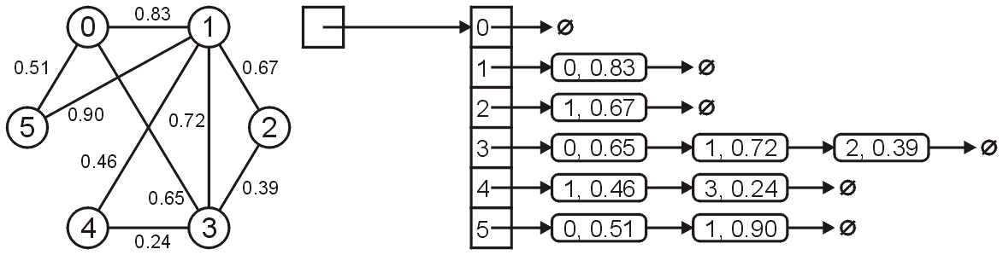
Adjacency List – Weighted Graphs
An adjacency list for a weighted graph contains two elements
First element for the vertex
Second element for the weight of that edge
When the vertices are identified by a name (i.e., string)
Hash-table of lists is used to implement the adjacency list
Array
Linked list

Slide 39
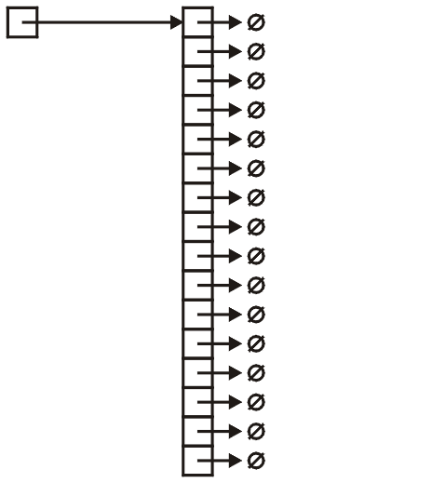
Adjacency List – Implementation
Node to store adjacent vertex and weight of the edge
class SingleNode {
private:
int adjacent_vertex;
double edge_weight;
SingleNode * next_node;
};
Define and create Array
SingleNode * array;
array = new SingleNode[16];

Slide 40
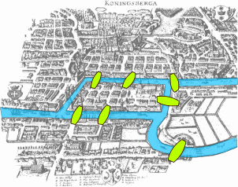
Graph Problems – Euler Tour
A sequence of vertices that traverse all edges in the graph exactly once
Leonhard Euler in 1736
Laid the foundations of graph theory
Problem: To devise a walk through the city that would cross each of the seven bridges of Königsberg once and only once
Euler proved problem has no solution
Notes:
The city of Königsberg (now Kaliningrad, Russia) was set on both sides of the Pregel River

Slide 41

Graph Problems – Hamiltonian Cycle
Is there a simple cycle that connects all vertices in the graph
NP-Complete
Knight’s Tour of chessboard
A sequence of knight’s moves
Visit every square of a chessboard precisely once
Returns to its initial square

Slide 42
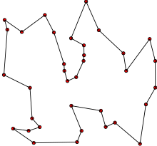
Graph Problems – Traveling Salesman
A salesman wishes to
Visit a number of towns, and then
Return to his starting town
Given the travelling times between towns, how should the travel be planned, so that:
He visits each town exactly once, and
He travels in as short time as possible
Problem: Given a weighted graph G, provide shortest cycle that contains all vertices in G
NP-Hard problem

Slide 43
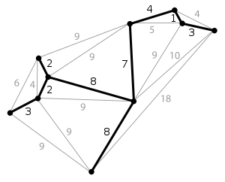
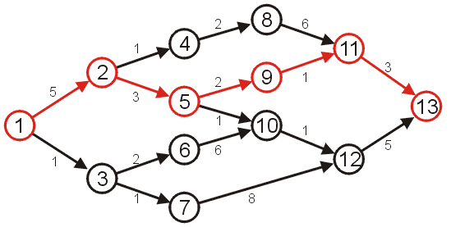
Graph Problems – Others
Minimum-cost spanning tree
Given a weighted graph G, determine a spanning tree with minimum total edge cost
Single-source shortest path
Given a weighted graph G and a source vertex v in G, determine the shortest paths from v to all other vertices in G

Slide 44
Any Question So Far?

Slide 45
Undirected Graphs – Definition
An undirected Graph ADT is a collection of vertices
V = {v₁, v₂, ..., v_{n}}
The number of vertices is denoted by |V| = n
Associated with this is a collection E of unordered pairs {v_{i}, v_{j}} termed edges which connect the vertices
Maximum number of edges in an undirected graph is O(|V|²)
Assumption: A vertex is never adjacent to itself (for this course)
For example, {v₁, v₁} will not define an edge
Many data structures can implement abstract undirected graphs
Adjacency matrices
Adjacency lists

